Slide 1
Individual homework
Cupeș Andrei, group 912

Slide 2
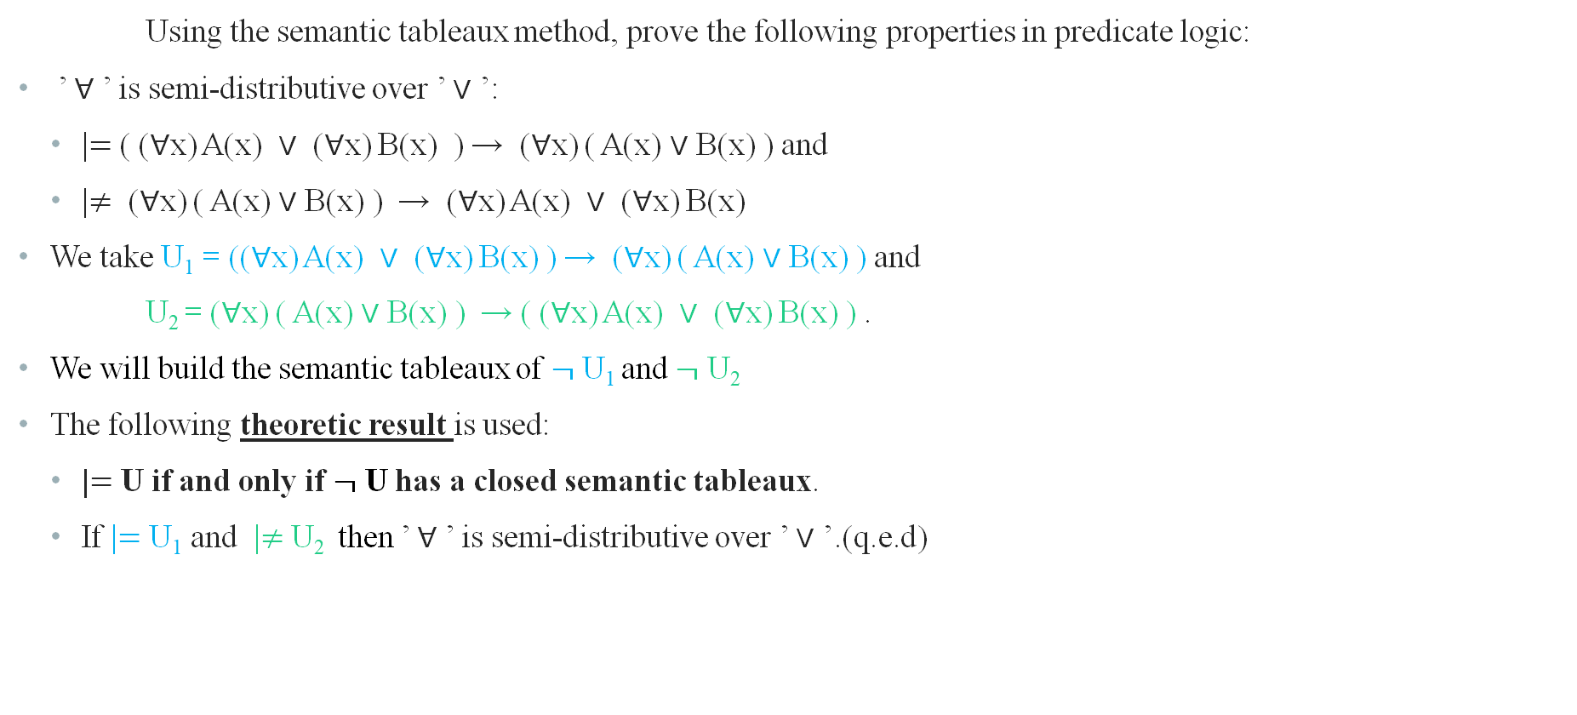
Exercise 5.2
Using the semantic tableaux method, prove the following properties in predicate logic:
’ ∀ ’ is semi-distributive over ’ ∨ ’:
|$=$ ( (∀x) A(x) ∨ (∀x) B(x) ) → (∀x) ( A(x) ∨ B(x) ) and
|$≠$ (∀x) ( A(x) ∨ B(x) ) → (∀x) A(x) ∨ (∀x) B(x)
We take U₁ = ((∀x) A(x) ∨ (∀x) B(x) ) → (∀x) ( A(x) ∨ B(x) ) and
U₂ = (∀x) ( A(x) ∨ B(x) ) → ( (∀x) A(x) ∨ (∀x) B(x) ) .
We will build the semantic tableaux of $¬$ U₁ and $¬$ U₂
The following theoretic result is used:
|$=$ U if and only if $¬$ U has a closed semantic tableaux.
If |$=$ U₁ and |$≠$ U₂ then ’ ∀ ’ is semi-distributive over ’ ∨ ’.(q.e.d)

Slide 3
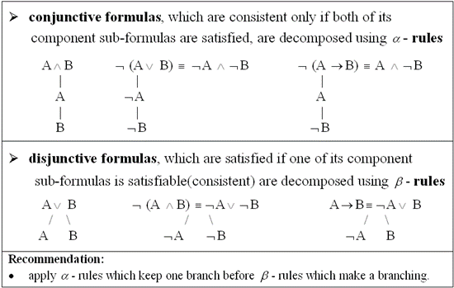
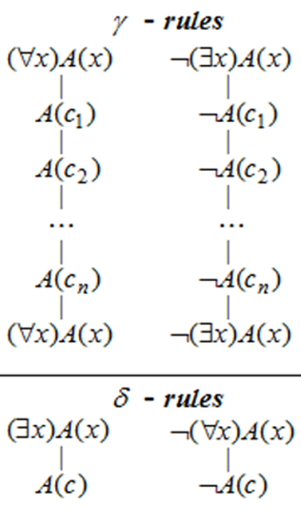



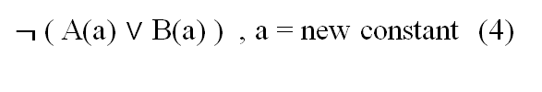
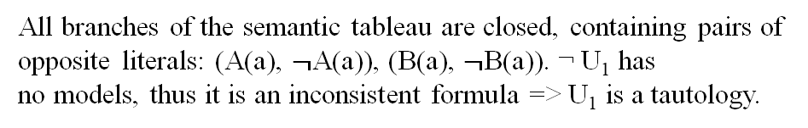

$¬$U₁ = $¬$( ( (∀x) A(x) ∨ (∀x) B(x)) → (∀x) ( A(x) ∨ B(x) ) ) (1)
α rule for (1)
(∀x) A(x) ∨ (∀x) B(x) (2)
(3) ≡ (∃x) $¬$ ( A(x) ∨ B(x) ) ;
$¬$(∀x) ( A(x) ∨ B(x) (3)
δ rule for (3)
$¬$ ( A(a) ∨ B(a) ) , a = new constant (4)
α rule for (4)
$¬$ A(a)
$¬$ B(a)
β rule for (2)
(∀x) A(x)
(∀x) B(x)
γ rule, a=used for instantation
γ rule, a=used for instantation
A(a)
B(a)
(∀x) A(x)
(∀x) B(x)
⦻
⦻
All branches of the semantic tableau are closed, containing pairs of opposite literals: (A(a), $¬$A(a)), (B(a), $¬$B(a)). ¬ U₁ has no models, thus it is an inconsistent formula => U₁ is a tautology.​

Slide 4



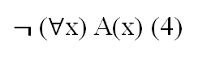
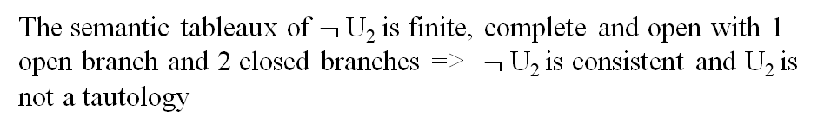
$¬$U₂ = $¬$( (∀x) ( A(x) ∨ B(x) ) → ( (∀x) A(x) ∨ (∀x) B(x) ) ) (1)
α rule for (1)
(∀x) ( A(x) ∨ B(x) (2)
$¬$((∀x) A(x) ∨ (∀x) B(x)) (3)
α rule for (3)
$¬$ (∀x) A(x) (4)
$¬$ (∀x) B(x) (5)
δ rule for (4) , a= new constant
$¬$ A(a)
δ rule for (5) , b= new constant
$¬$ B(b)
γ rule for (2)
A(a) ∨ B(a) , a = used for instantation (6)
A(b) ∨ B(b) , b = used for instantation (7)
(∀x)(A(x) ∨ B(x)) , copy of formula (2)
β rule for (7)
A(a)
B(a)
β rule for (6)
The semantic tableaux of $¬$U₂ is finite, complete and open with 1 open branch and 2 closed branches => ​ $¬$U₂ is consistent and U₂ is not a tautology
⦻
A(b)
B(b)
⦻

Slide 5
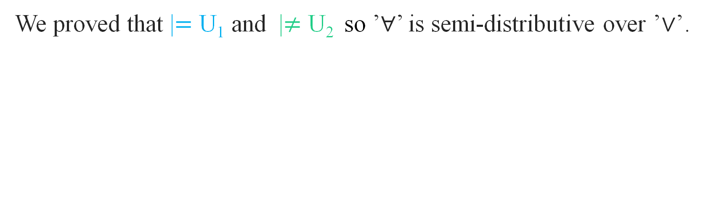
Conclusion
We proved that |$=$ U₁ and |$≠$ U₂ so ’∀’ is semi-distributive over ’∨’.

